Slide 1
Measuring Roles and Positions in Networks

Slide 2
Social networks, graphs, matrices
Graph Theory
“The Graph”
Linkage
Analogy
Matrix Algebra
“The Matrix”
Social Systems
“The Network”
Measurement

Slide 3

Three ways of talking about "social networks"
Social network theory is a branch of social science
  Allows for the specification of processes occurring in social systems :
  Happens in natural language and relies on substantive intuitions
  The relevant "concepts" are by their nature "fuzzy"
Graph theory is a branch of pure mathematics
  Allows for the specification of "analogues" of fuzzy social network concepts stated in natural language in less ambiguous terms
Matrix algebra is a branch of applied mathematics
  Links to graph to theoretic concepts to allow for calculation and the development of "measures" and metric representations of social network concepts (e.g. “centrality”)

Slide 4
Three ways of talking about "social networks"
Three different types of concepts:
  Social Science Concepts:
    Roles, Social Position, Relational Similarity
  Graph Theoretic Concept:
    Equivalence of nodes in a graph
  Matrix Representation of the Graph Theoretic Concept:
    Blocks in a Matrix
  The graph-theoretic notion of equivalence a does for the classic notion notion of social roles (taken from functionalist sociology and social anthropology) what centrality does for prominence
    Equivalence can be thought of as a partition of the set of vertices in a graph into a set of disjoint classes.
    Each subset of vertices in the same class can be thought of as playing the same role or occupying the same position

Slide 5
Roles and positions in networks (Graph Theory)
Finding an equivalence relations among vertices can thus be thought of as imposing a classification on the vertex set
  Given a graph
    G = (V, E)
  Find a partition of V compatible with E
A Partition P = {C₁...C_{k}} of V is a set of non-empty, disjoint subsets such that:
  V = U_{i} C_{i}
  Each vertex v belongs to exactly one class or block
  An equivalence relation (reflexive, symmetric, transitive) on V defines a partition

Slide 6
Roles and positions in networks (Graph Theory)
Given a partitioning of the set of vertices into disjoint classes we may be interested in the connection across the blocks
  Two blocks are connected via the adjacency relations of their respective vertices to one another in the original graph
A reduced representation showing the roles and their relations is called a role graph or image graph
  Role assignment can thus be thought of as a "data reduction" technique for networks
  Meaningful structure may be captured at the image or role graph level rather than at the "individual" vertex level
  Vertex classification defines "similarity" and reduces network complexity
    This may be particularly appropriate for large, irregular graphs
  Vertex behavior may display regularities at the level of role or position that it fails to display at the individual level

Slide 7
Notions of Equivalence: Structural Equivalence
The simplest conceptualization of role equivalence is structural equivalence
  Two vertices u and v are structural equivalent iff they have the same pattern of relations with the same actors
If G = (V, E) and V -> W is a role assignment, the relation R is a structural equivalence iff for all u, v in V:
  uRv implies that the outgoing set of neighbors of u and the outgoing set of neighbors of v are the same
  uRv implies that the incoming set of neighbors of u and the incoming set of neighbors of v are the same

Slide 8



Notions of Equivalence: Structural Equivalence
Intuition:
  Two people are structurally equivalent if they are friends with the same set of people
  Two papers are structurally equivalent if they cite the same set of other papers
  Two species are structurally equivalent if they feed on the same set of prey
  Two clubs are structurally equivalent if the share the same set of members
  Two countries structural equivalent if they trade with the same set of countries

Slide 9
Notions of Equivalence: Structural Equivalence
If two actors are structurally equivalent they have the same graph theoretic attributes, however, reverse is not the case
  Actors share the same neighborhood and their neighbors share the same relations
  Actors are actually part of the same cohesive subset (clique and its generalizations)
  Structural equivalence is a purely local concept

Slide 10
Notions of Equivalence: Structural Equivalence
The simplest conceptualization of role equivalence is structural equivalence
  Two vertices u and v are structural equivalent iff they have the same pattern of relations with other actors
a
b
g
h
e
f
c
d
i
j
Borgatti and Everett’s
“Thinking Graph”

Slide 11
Notions of Equivalence: Structural Equivalence
The simplest conceptualization of role equivalence is structural equivalence
  Two vertices u and v are structural equivalent iff they have the same pattern of relations with the same actors
a
b
g
h
e
f
c
d
i
j
Borgatti and Everett’s
“Thinking Graph”

Slide 12
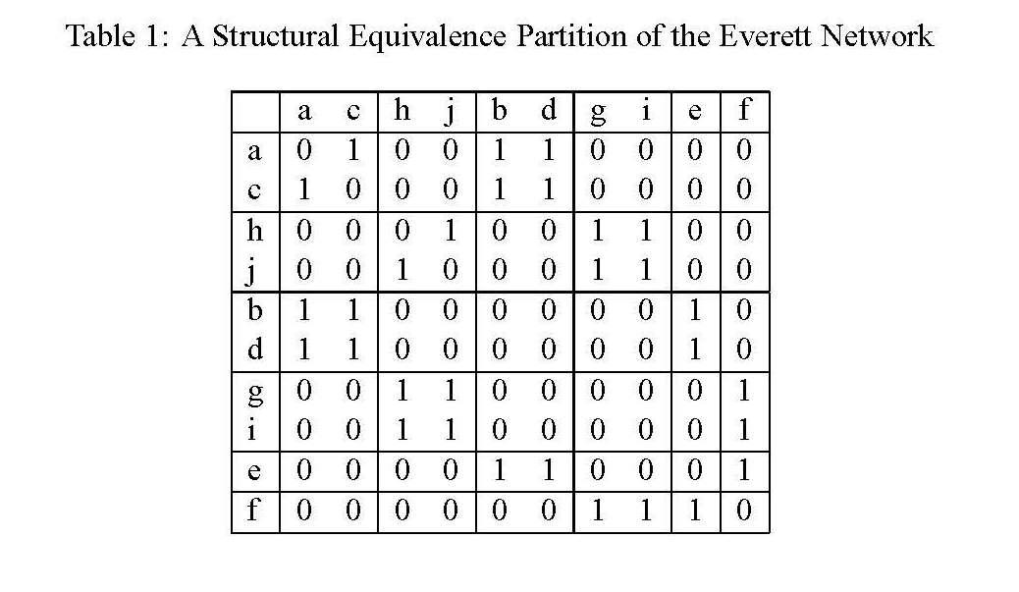

Slide 13
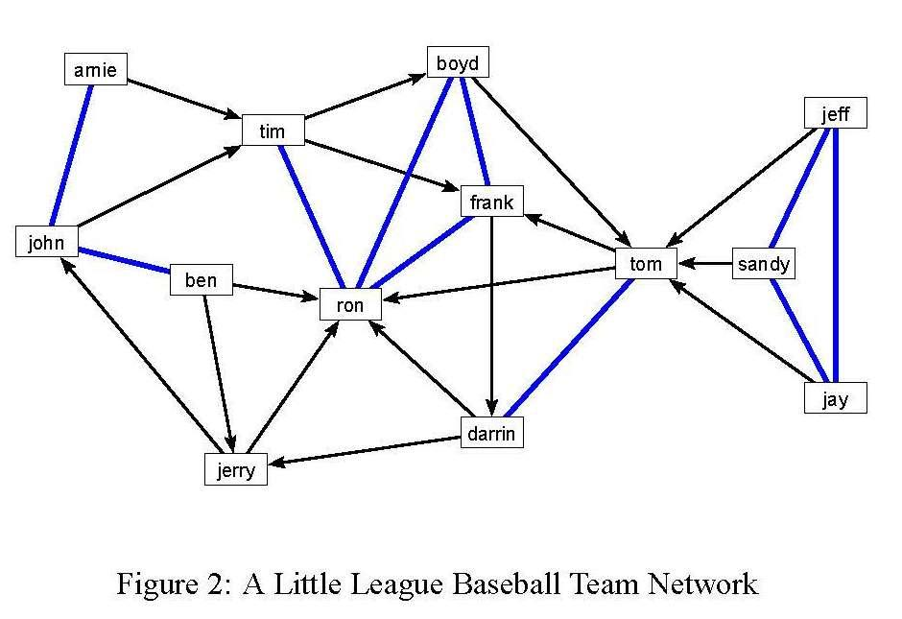

Slide 15
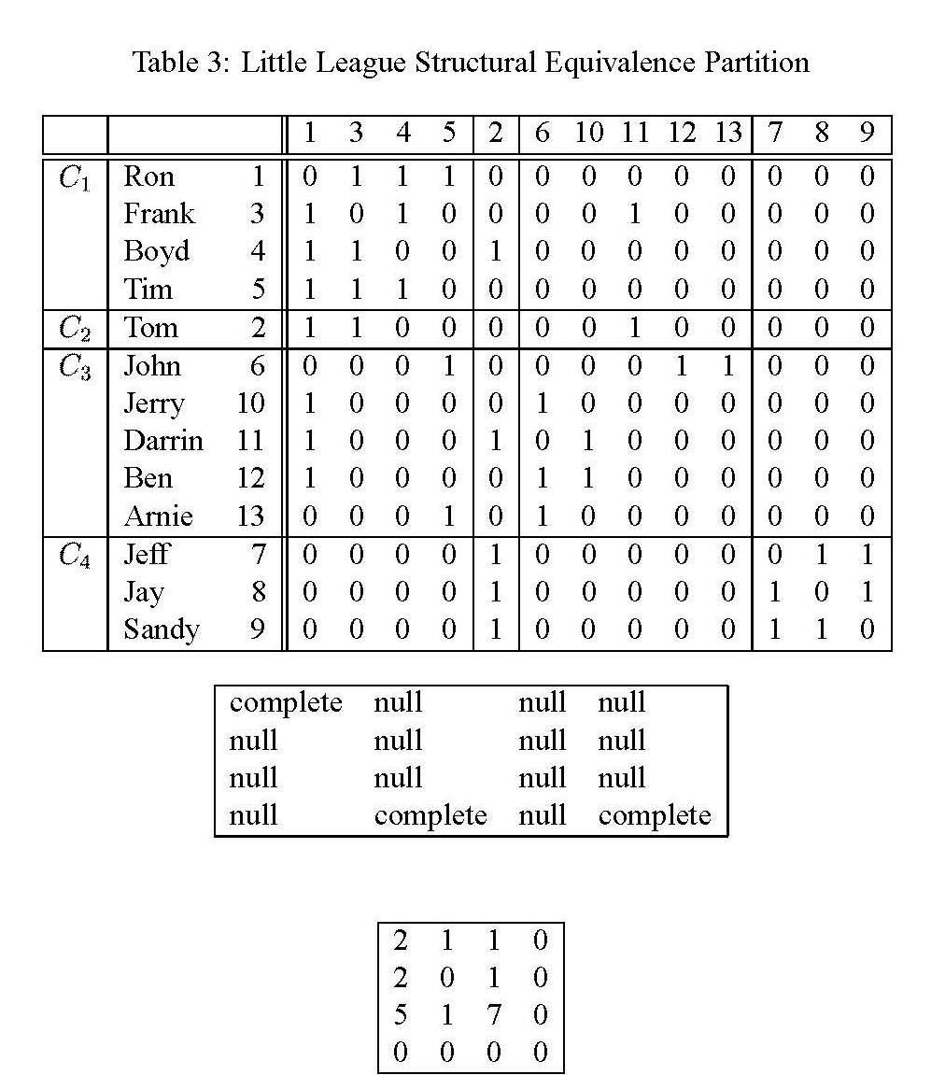

Slide 16
Notions of Equivalence: Regular Equivalence
Theoretically, the notion of role implies similar patterns of connectivity to similarly positioned actors not to literally the same actors
  Structural equivalence is the wrong measure in this case (Borgatti and Everett 1992)
    Need a more flexible notion of equivalence: Regular equivalence
a
b
g
h
e
f
c
d
i
j
Borgatti and Everett’s
“Thinking Graph”

Slide 17
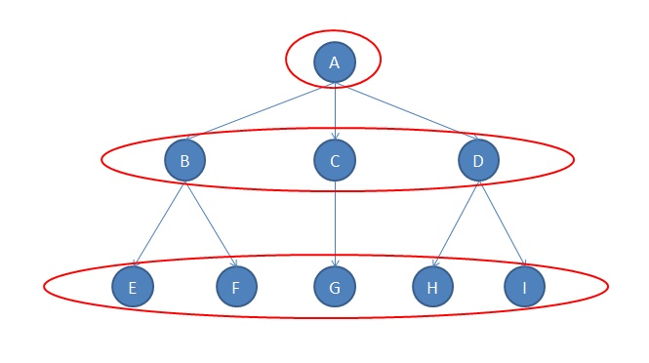
Notions of Equivalence: Regular Equivalence
Structural and regular equivalence embody two intuitive but different conceptions of “similarity” between two actors:
  Structural equivalence:
    Two actors are similar if they have similar relationships to the same actors or objects
  Regular equivalence:
    Two actors are similar if they have similar relationships to similar actors or objects

Slide 18
Notions of Equivalence: Regular Equivalence
Intuition:
  Two people are regularly equivalent if they are friends with the similar set of people
  Two papers are regularly equivalent if they cite a similar set of other papers
  Two species are regularly equivalent if they feed on similar set of prey
  Two clubs are regularly equivalent if they share similar set of members
  Two countries are regularly equivalent if they trade with a similar set of countries

Slide 19
Notions of Equivalence: Regular Equivalence
Intuition:
  Two people are regularly equivalent if they are friends with the similar set of people
  Two papers are regularly equivalent if they cite a similar set of other papers
  Two species are regularly equivalent if they feed on similar set of prey
  Two clubs are regularly equivalent if they share similar set of members
  Two countries are regularly equivalent if they trade with a similar set of countries
Where similarity is graph theoretic similarity!

Slide 20
Notions of Equivalence: Regular Equivalence
Theoretically, the notion of role implies similar patterns of connectivity to similarly positioned actors not to literally the same actors
  Structural equivalence is the wrong measure in this case (Borgatti and Everett 1992)
    Need a more flexible notion of equivalence: Regular equivalence
a
b
g
h
e
f
c
d
i
j
Borgatti and Everett’s
“Thinking Graph”

Slide 21
Notions of Equivalence: Regular Equivalence
Theoretically, the notion of role implies similar patterns of connectivity to similarly positioned actors not to literally the same actors
  Structural equivalence is the wrong measure in this case (Borgatti and Everett 1992)
    Need a more flexible notion of equivalence: Regular equivalence
a
b
g
h
e
f
c
d
i
j
Borgatti and Everett’s
“Thinking Graph”

Slide 22
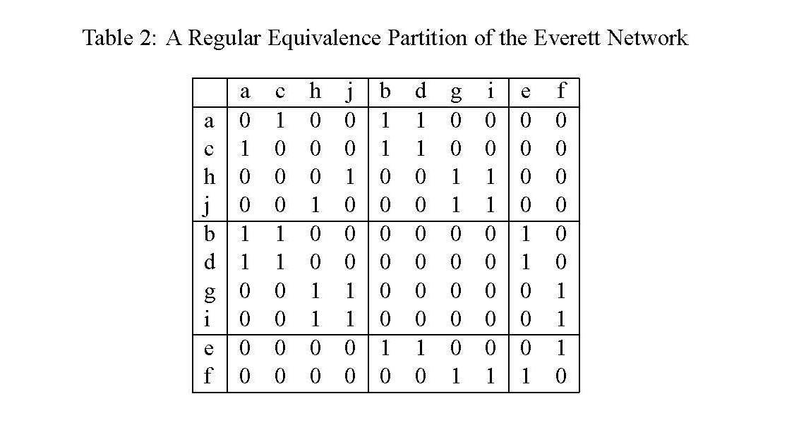

Slide 23
Notions of Equivalence: Structural Equivalence
If two actors are regularly equivalent they have the same graph theoretic attributes, and vice versa:
  If two actors share all graph theoretic attributes they are regularly equivalent
  Regular equivalence is a non-local concept
a
b
g
h
e
f
c
d
i
j
Borgatti and Everett’s
“Thinking Graph”

Slide 24
Notions of Equivalence: Structural Equivalence
If two actors are regularly equivalent they have the same graph theoretic attributes, and vice versa:
  If two actors share all graph theoretic attributes they are regularly equivalent
  Regular equivalence is a non-local concept
  Simple trick: if you have a graph and lose the “vertex labels” nodes that cannot be told apart are regularly equivalent
Borgatti and Everett’s
“Thinking Graph”

Slide 25

Blockmodeling
In most real world applications the strong graph-theoretic definitions of structural or regular equivalence are unlikely to hold
  Attempts to come up with stochastic approximations of graph theoretic equivalence relations for the purposes of vertex classification using matrix algebra is called blockmodeling

Slide 26
Blockmodeling
In most real world applications the strong graph-theoretic definitions of structural or regular equivalence are unlikely to hold
  Rather than thinking that two or more actors are exactly structural or regulatory equivalent we come up with a measurement criterion for determining degrees of equivalence
    With exact equivalence as a limiting case

Slide 27
Blockmodeling
What is a blockmodel?
  A procedure to reorder the rows of matrix (representing nodes and their relations) such that:
    Rows that are close together are closer to being (structural or regularly) equivalent than rows that are far apart
      The matrix can then be divided into blocks
    Blocks contain disjoint set of actors and thus define “positions” in the network
  Actors in block have connections among themselves
    Diagonal blocks
  Actors in a block also have connections with actors in other blocks
    Off-diagonal blocks
We can think of blockmodeling as an attempt to reduce a matrix of N x N actors and their relations to a reduced matrix of B x B blocks and their relations

Slide 28
Blockmodeling
For a given graph G, a blockmodel consists of two parts:
  A partition P = {P₁, P₂, ...P_{k}} into k disjoint subsets called the positions of G
  A set of matrices B (called image matrices) that represent hypotheses on the relations between positions
  Blockmodels build on minimal relaxations of structural equivalence that still correspond to some minimal numbers of positions in the network
A blockmodel is thus a simplified representation of the original network whose basic elements are the positions
  The basic task is to ascertain to what extent the observed network approximates some idealized (theoretical) image of the "underlying" role relations

Slide 29
Blockmodeling
For a given graph G, a blockmodel consists of two parts:
  A partition P = {P₁, P₂, ...P_{k}} into k disjoint subsets called the positions of G
  A set of matrices B (called image matrices) that represent hypotheses on the relations between positions
  Blockmodels build on minimal relaxations of structural equivalence that still correspond to some minimal numbers of positions in the network
From the point of view of the adjacency matrix A a blockmodel is defined as:
  A permutation (shuffling of the rows and columns) of A
  Such that vertices in the same position end up in consecutive rows and columns

Slide 30
Blockmodeling
Two basic approaches to blockmodeling:
  So-called "deterministic" approaches (bottom-up, inductive)
  So-called "stochastic" approaches (top-down, deductive)
Basic task in deterministic blockmodeling is to come up with a criterion for "approximate" equivalence:
  The Euclidean distance (Burt 1976)
  The Pearson product-moment correlation (Breiger, Boorman and Arabie 1975)

Slide 31

Blockmodeling (Deterministic)
For two actors i and j, the Euclidean distance is defined as:

Slide 32
Blockmodeling (Deterministic)
In Burt's (1976) Euclidean distance approach, the basic idea is to:
  Generate the distance matrix D
  And the use a scaling method (e.g. MDS, hierarchical clustering) to come up with a reduced form representation of the various groups

Slide 33
Blockmodeling (Deterministic)
For a given adjacency matrix A, the correlation matrix C is the matrix containing the Pearson product moment correlations between the respective row and columns for two actors r_{ij}

Slide 34
Blockmodeling (Deterministic)
In Breiger, Boorman and Arabie's CONCOR strategy, the basic idea is to:
  Generate the (initial) correlation matrix C₁ from A
  Iteratively obtain further correlation matrices of correlation matrices {C_{2,} C₃, ...}
  until we have a "final" correlation matrix C_{k} that contains only +1 and -1 entries
  Place actors that have +1 relations next to another

Slide 35
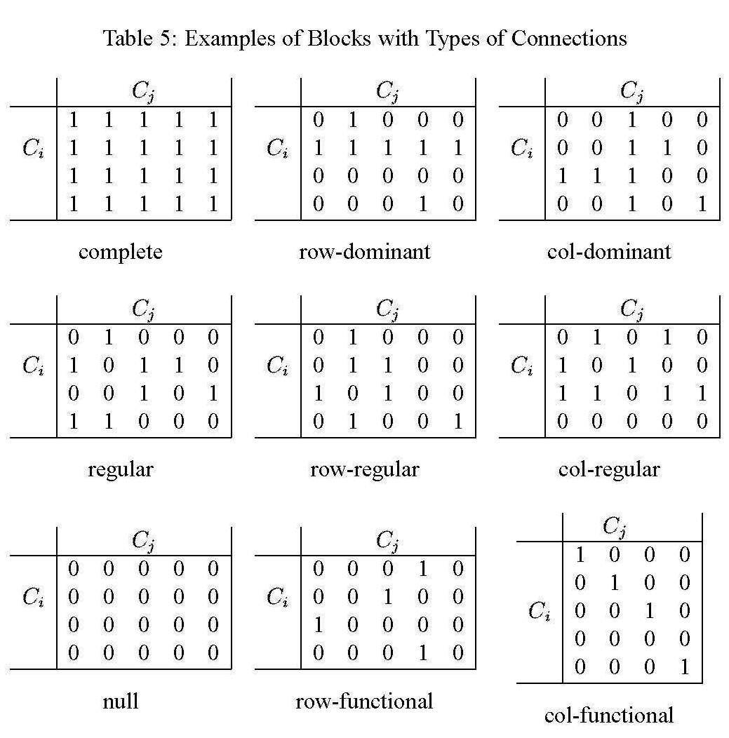
Generalized and Stochastic blockmodeling
In generalized blockmodeling an idealized "image" of the role structure is pre-specified in advance
  We then use statistical techniques to ascertain how close the observed network is to the specified structure
  We may choose from a "canned" list of theoretically interesting patterns of role relations

Slide 36
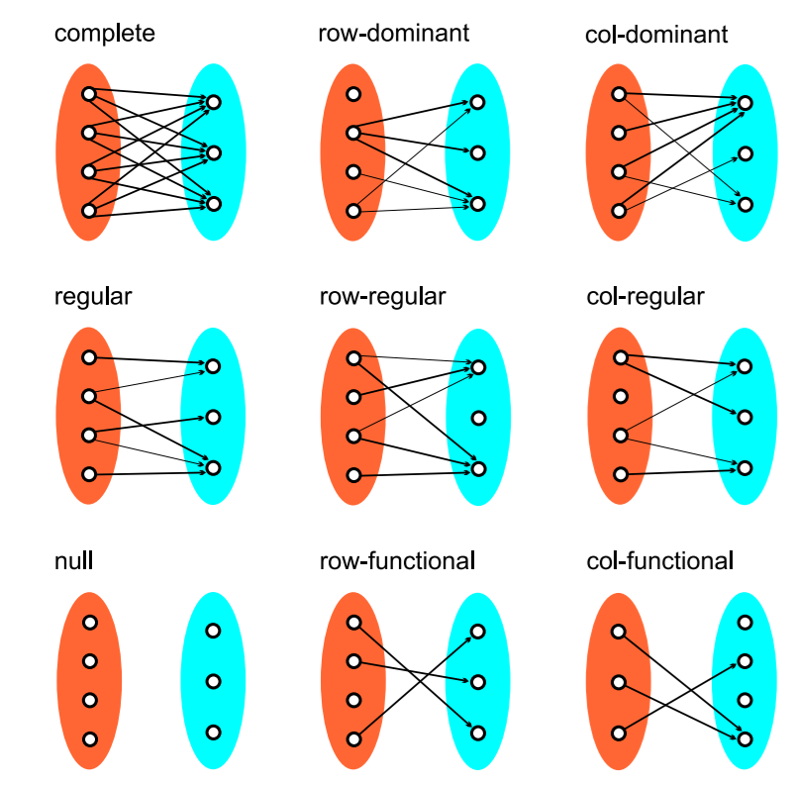
Types of canned “inter-block” relations
Complete
Row(Column) Dominant
  A block has at least one unit in A(B) that sends(receives) ties to(from) all units in B(A)
Regular
  Each unit in A sends to at least one unit in B and each unit in B receives from at least one unit in A
Row(Column) Regular
  Each unit in A(B) sends(receives) to(from) at least one unit in B(A)
Null
Row(Column) Functional
  Each unit in B(A) receives(sends) ties from(to) at least one unit in A(B)

Slide 37
Extensions of blockmodeling
Blockmodeling for two mode networks
Blockmodeling for valued graphs
Blockmodeling for multi-relational networks
In all cases procedure is similar:
  Come up with a Blocking criterion
    The Blocking criterion produces:
      A (dis)similarity matrix between nodes
      A clustering of nodes into classes:
  Come up with a Modelling criterion
    The modelling criterion produces:
      A reduced image matrix of blocks and their internal and external relations
      Which may (or may not) be compared to a hypothesized ideal image matrix

